Slide 1
[ ISG25JFA001 ] - [ ONLINE FOOD DELIVERY SYSTEM ]
1. Devi Prasad Dash
2. Kanha Sahu
3. Asutosh Mishra
4. Piyush Das
Date of Design : 11/07/2025

Slide 2
Wireframe diagram
A wireframe is a diagram or a set of diagrams that consists of simple lines and shapes representing the skeleton of a website or an application's user interface (UI) and core functionality
Wireframes are simple block diagrams that show the placement of elements in a user interface
2

Slide 3
Wireframe Diagrams : ONLINE FOOD DELIVERY SYSTEM
3

Slide 4
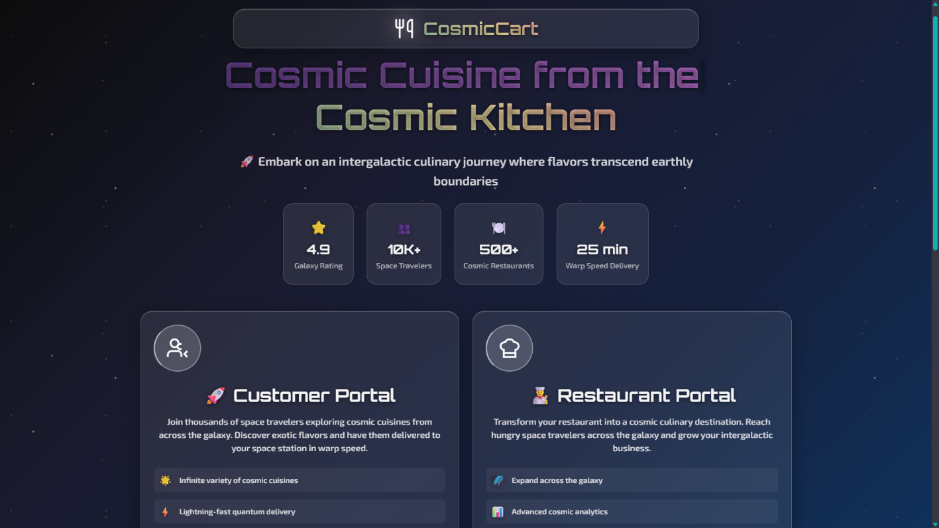
Landing Page

Slide 5
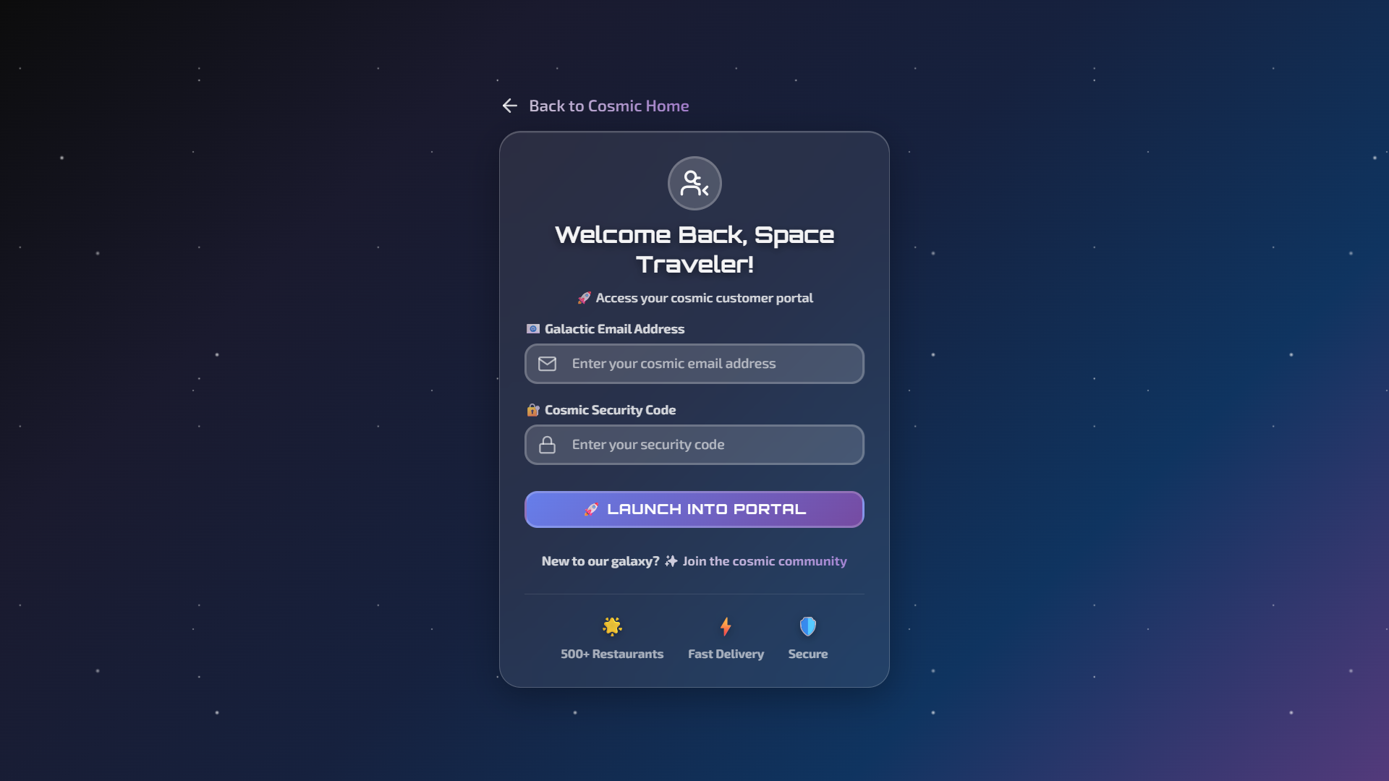
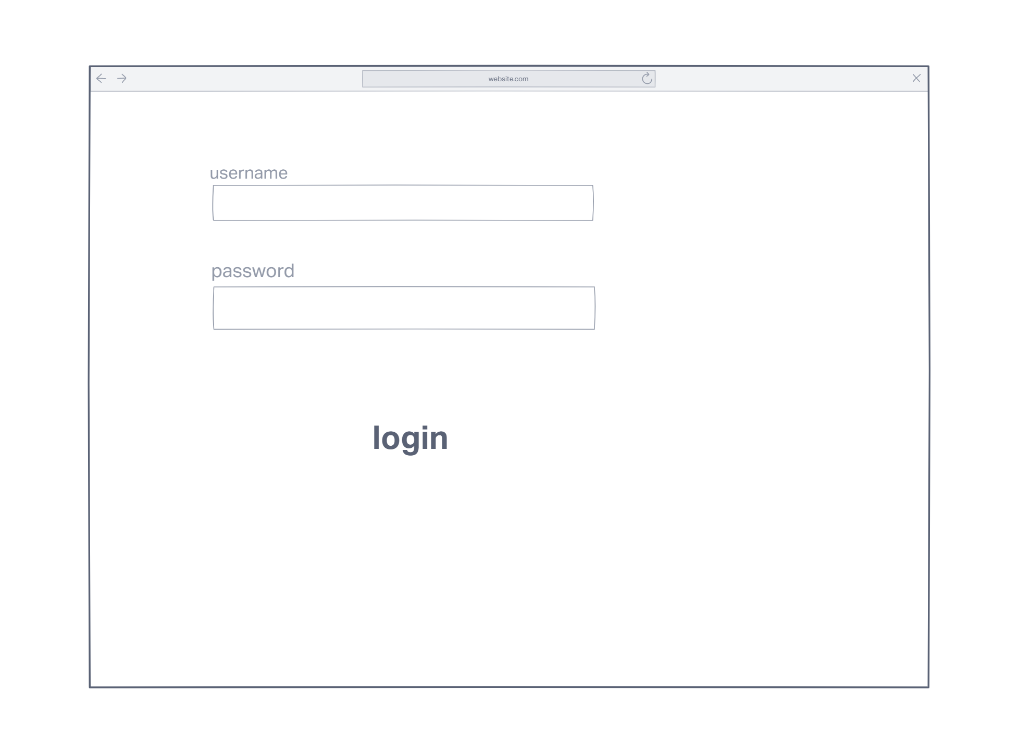
Customer Login
4

Slide 6
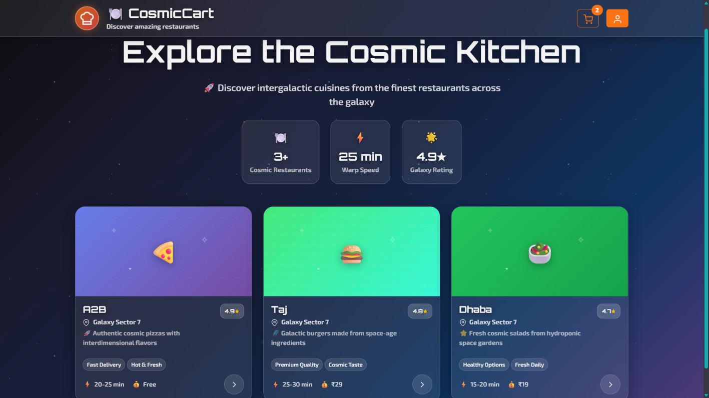
Customer Dashboard
4

Slide 7
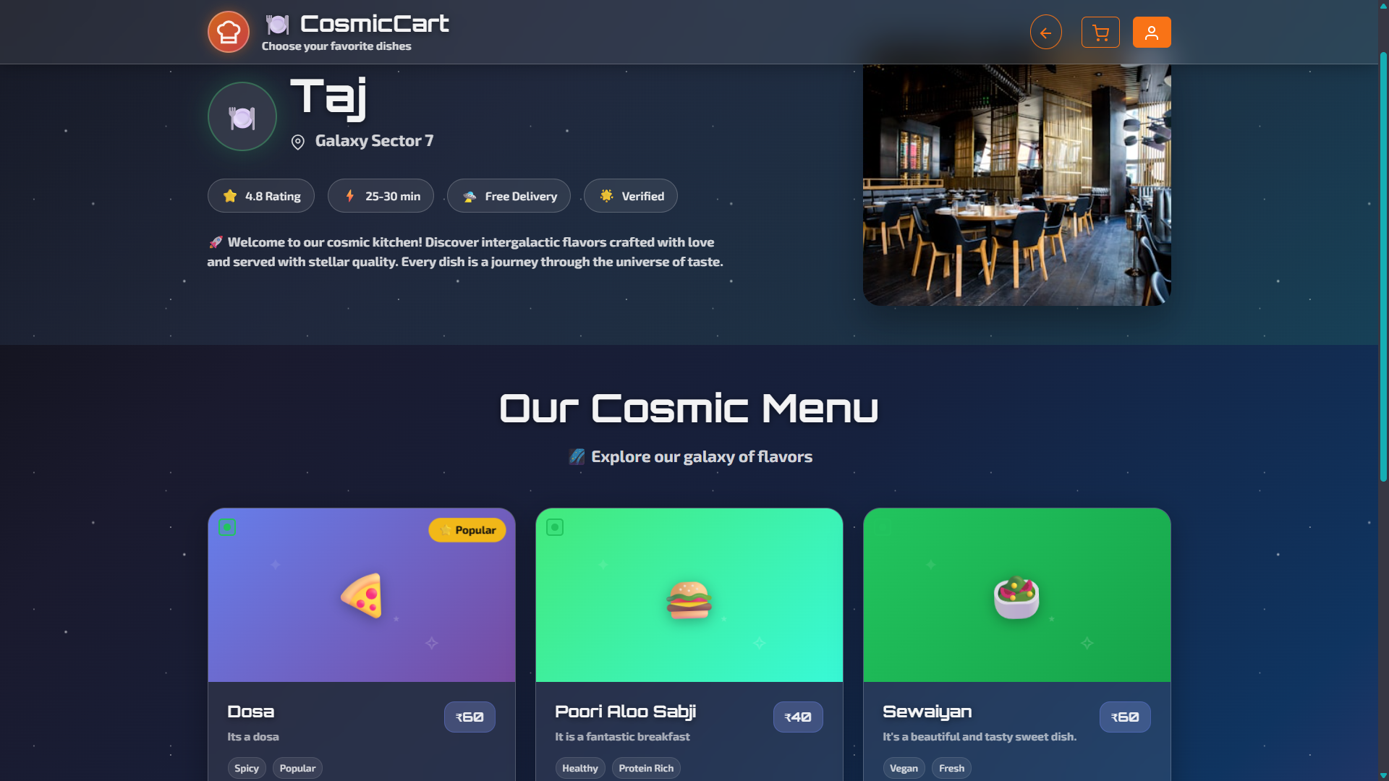
Items
4

Slide 8
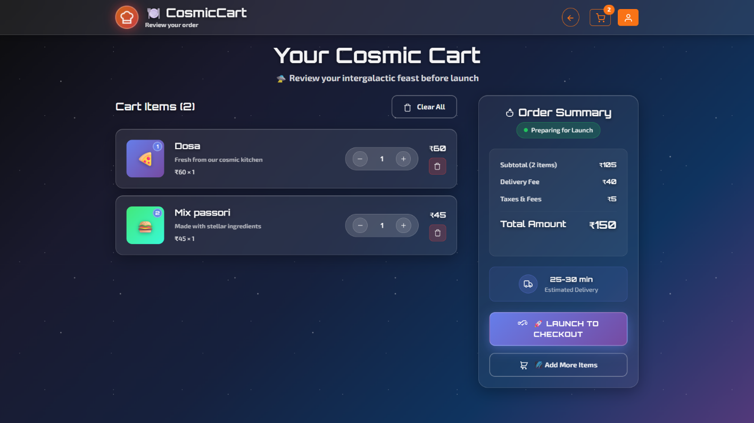
Cart

Slide 9
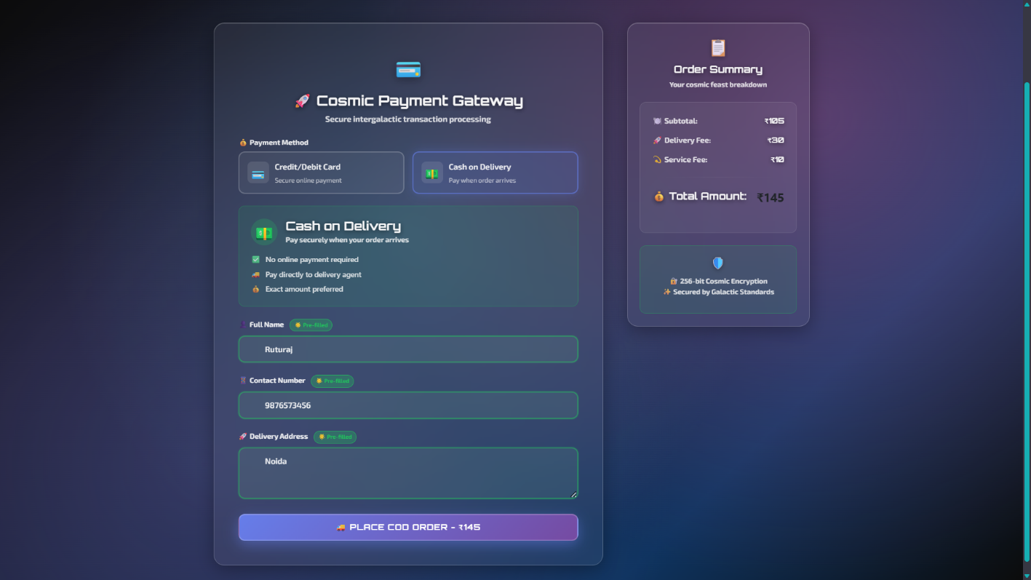
Payment Information

Slide 10
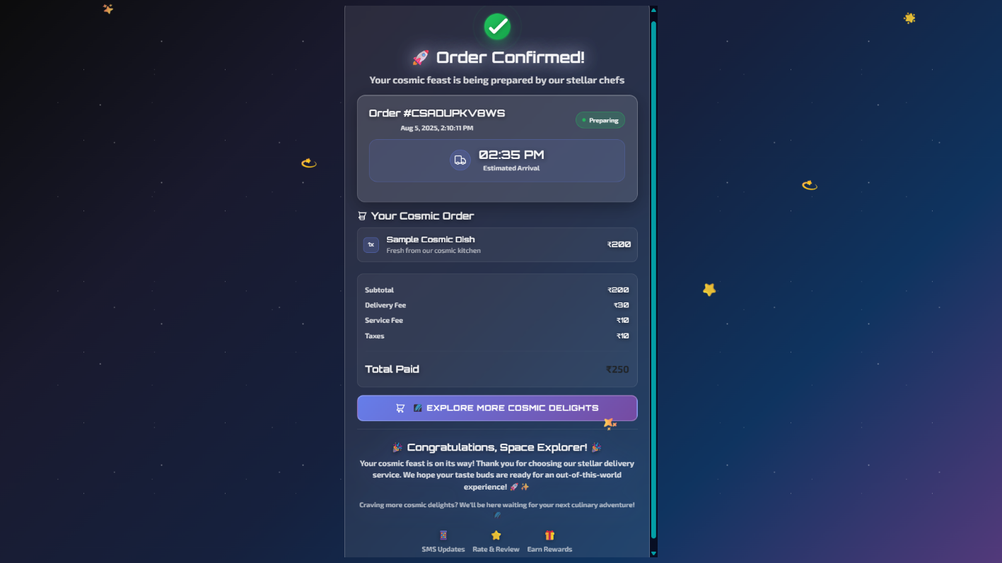
Payment Success
4

Slide 11
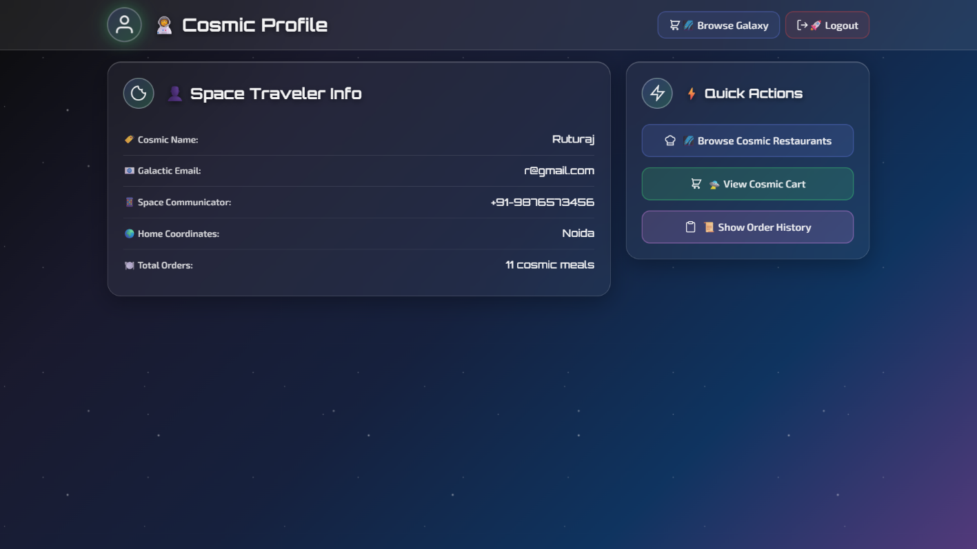
User Profile Page

Slide 12
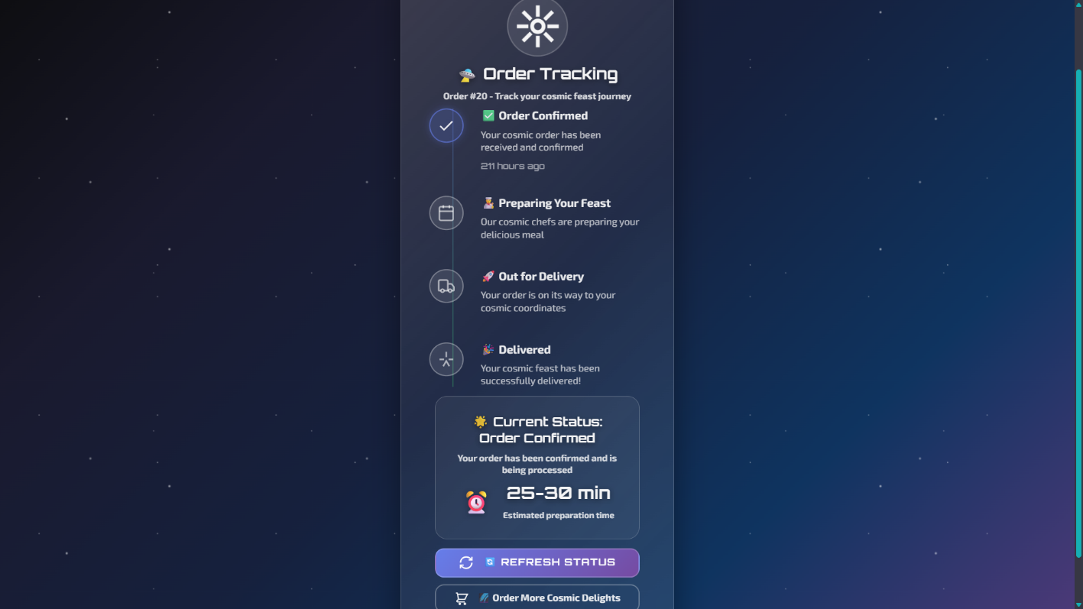
Track Order
4

Slide 13
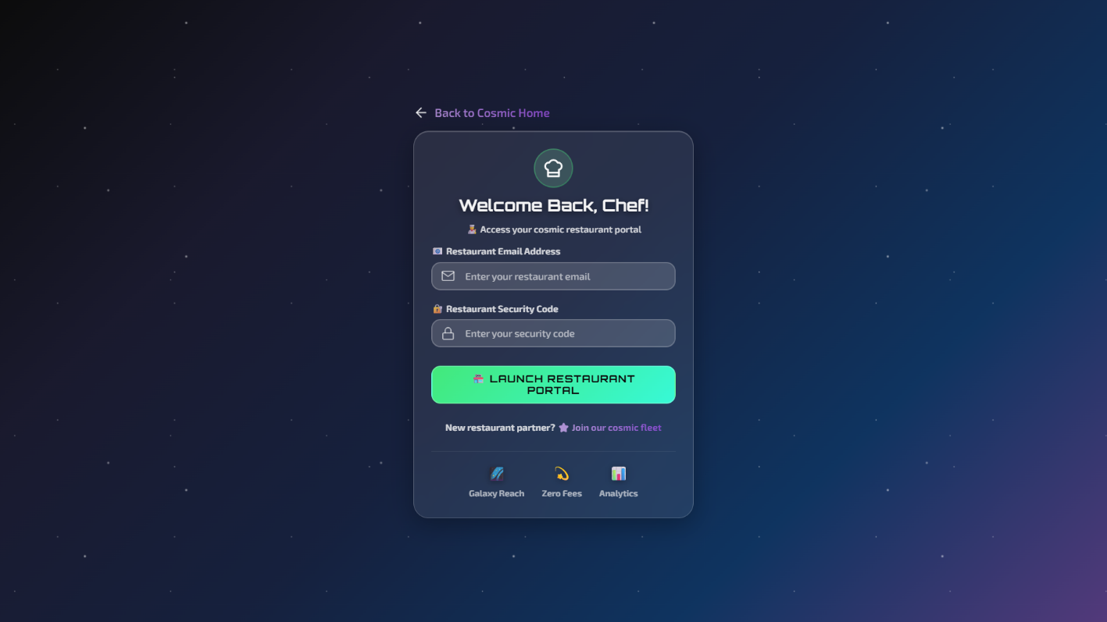
Restaurant Login

Slide 14
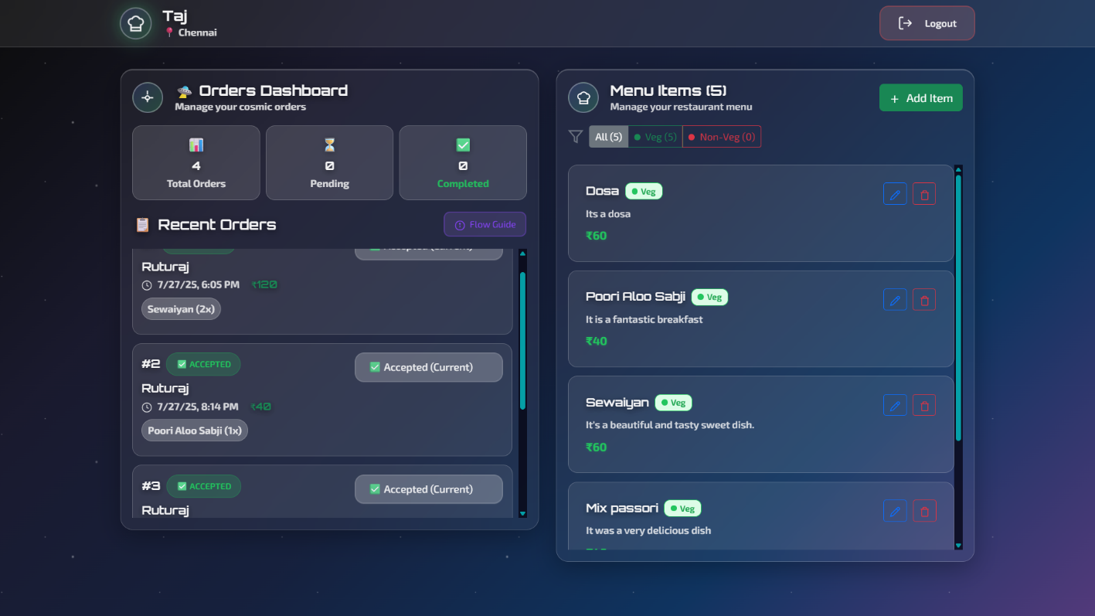
Restaurant Dashboard

Slide 15
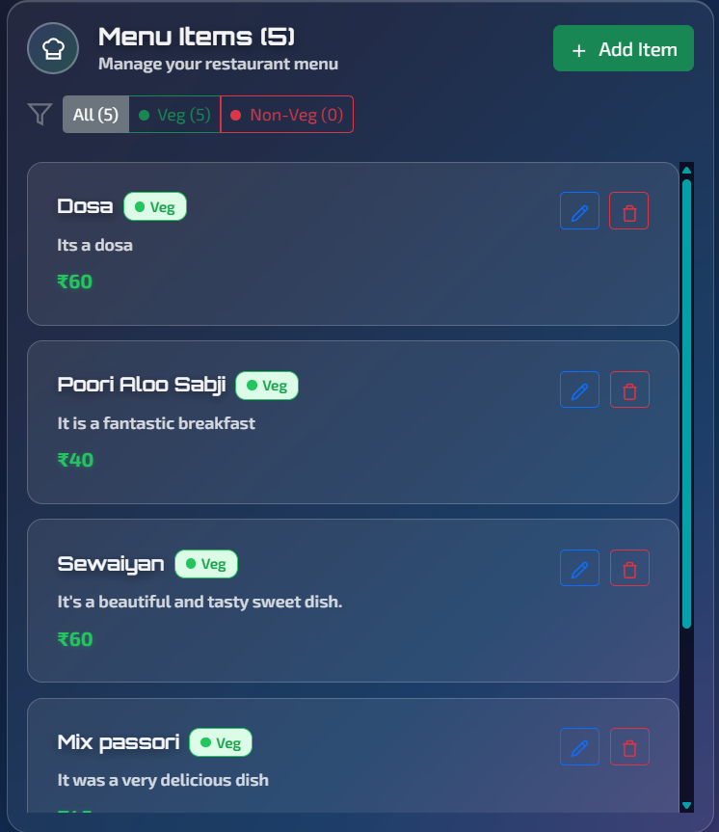
Category Panel

Slide 16
Thank You!
Member Name
1.Devi Prasad Dash
2.Kanha Sahu
3.Asutosh Mishra
4.Piyush Das
Member email id:
Deviprasad.Dash@cognizant.com
Kanha.Sahu@cognizant.com
Asutosh.Mishra@cognizant.com
Piyush.Das@cognizant.com

